Slide 1
Optimization and Application of Fuzzy Logic Controllers in HOMER Software
Enhancing System Performance in Energy Modeling

Slide 2
Introduction
My project focuses on enhancing the HOMER software by integrating a Fuzzy Logic Controller (FLC), which is an intelligent control system optimized using Particle Swarm Optimization (PSO) and Genetic Algorithms (GA). This integration is designed to significantly improve the simulation capabilities of the software, enabling more accurate and efficient management of renewable energy resources.

Slide 3
Project Objectives
Develop an Advanced Fuzzy Logic Controller (FLC)
Optimize FLC Performance Using PSO and GA
Conduct Comparative Efficiency Analysis

Slide 4
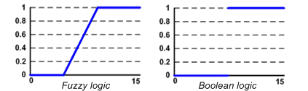
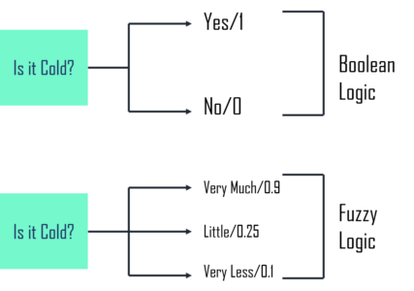
Fuzzy Logic Controller (FLC)
Concept of FLC:
A Fuzzy Logic Controller (FLC) is a control system that uses fuzzy logic to process data. Instead of a binary approach, fuzzy logic works on degrees of truth ranging between 0 and 1, allowing for more precise decisions

Slide 5
Fuzzy Logic Controller (FLC)
Importance of FLC:
Handling Uncertainty and Imprecision
Flexibility
No Need for Accurate Mathematical Models
Efficiency in Complex Systems

Slide 6
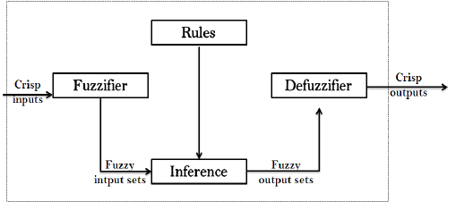
Fuzzy Logic Controller (FLC)
When FLC gets input (like temperature, speed, etc.), it processes this input in three main steps:
Fuzzification: This step changes regular numerical inputs into 'fuzzy' inputs, which are more like human language terms. For example, instead of saying the temperature is 73 degrees, it might say it's 'warm'.
Decision-Making: Here, the system uses the 'fuzzy' inputs and applies the rules set by the operator to figure out what to do next.
Defuzzification: This final step converts the fuzzy decisions back into specific actions or numerical outputs that the system can use to control something, like setting the temperature.

Slide 7
Particle Swarm Optimization(PSO)
Particle Swarm Optimization: A computational technique for solving optimization problems. Developed in 1995 by Kennedy and Eberhart. inspired by the social behavior of birds and fish.

Slide 8
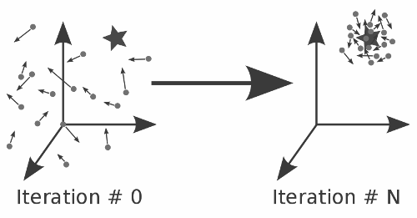
Basics Particle Swarm Optimization(PSO)
Why PSO?
Adaptable to various problems: PSO is versatile. Whether it's engineering design, financial forecasting, PSO can be applied to optimize a solution.
Few parameters to adjust: One strength of PSO is its simplicity. With just a few parameters to adjust, it's less prone to overfitting and is straightforward to implement.

Slide 9
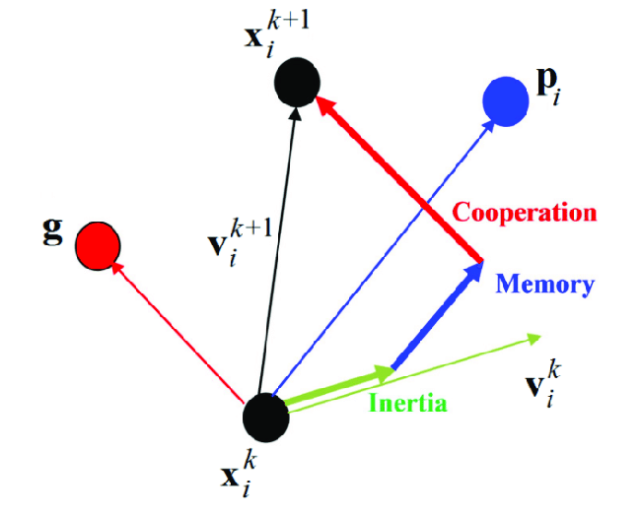
Basics Particle Swarm Optimization(PSO)
Each particle in PSO has the following attributes
Position: his represents a potential solution in the search space.
Velocity: This determines how much a particle's position changes in each iteration
Personal Best: The best position (solution) the particle has visited.
Global Best: The best position any particle in the swarm has visited.

Slide 10
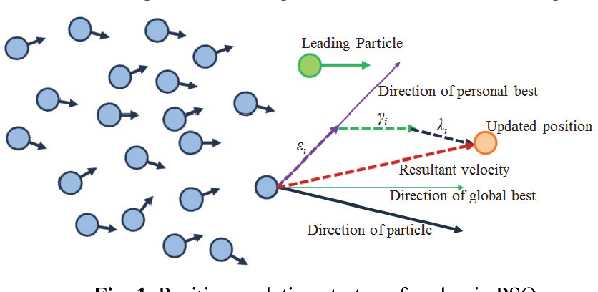
Basics Particle Swarm Optimization(PSO)
How PSO Works
Initialization: Each particle's position and velocity are initialized randomly.
Evaluation: Each particle's fitness is evaluated based on its current position using the objective function.
Update Personal Best: If the current position of the particle is better than its previous personal best, update its personal best.
Update Global Best: If a particle's personal best is better than the global best known to the swarm, update the global best.
Update Velocities and Positions: Each particle updates its velocity and position based on its own memory (personal best) and the knowledge of its neighbors (global best).
Loop: Steps 2-5 are repeated for a set number of iterations or until a termination criterion is met.

Slide 11

Genetic Algorithm(GA)
Genetic Algorithm (GA) is a type of evolutionary algorithm and a subset of artificial intelligence, inspired by the process of natural selection. This algorithm reflects the process of natural evolution, where the fittest individuals are selected for reproduction in order to produce offspring of the next generation.

Slide 12
Genetic Algorithm(GA)
How Genetic Algorithms work?
Population: GAs start with a randomly generated group of individuals (chromosomes), each representing a possible solution.
Fitness Function: Each individual's fitness is assessed to determine how close it is to the desired solution.
Selection: The fittest individuals are more likely to be chosen for reproduction, but less fit individuals might also be selected to maintain diversity.
Crossover: Selected individuals are paired to exchange segments of their genetic information, creating offspring.
Mutation: Random changes are introduced to some individuals, ensuring diversity and preventing convergence on suboptimal solutions.
New Generation: Offspring replace the previous generation and are used in the next iteration of the algorithm.
Termination: The algorithm repeats these steps over multiple generations, evolving towards an optimal solution. It stops when a maximum number of generations is reached or a satisfactory solution is found.

Slide 13

Motor Control with FLC
Before starting the main project, I first conducted a basic test. In this test, I created a simple control system (Fuzzy Logic Controller) to run a motor. Then, I improved it using two methods: Particle Swarm Optimization and Genetic Algorithm. This initial test helped me check that my approach was on track before using the control system with HOMER.

Slide 14
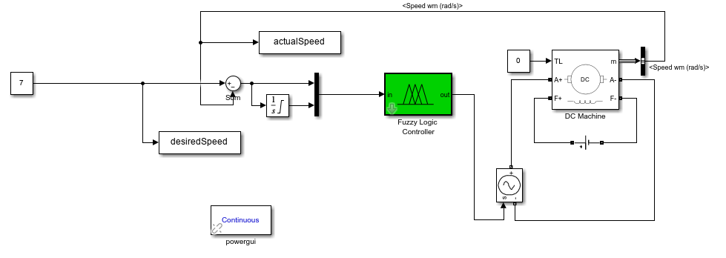
Motor Control with FLC
Simulink Model

Slide 15
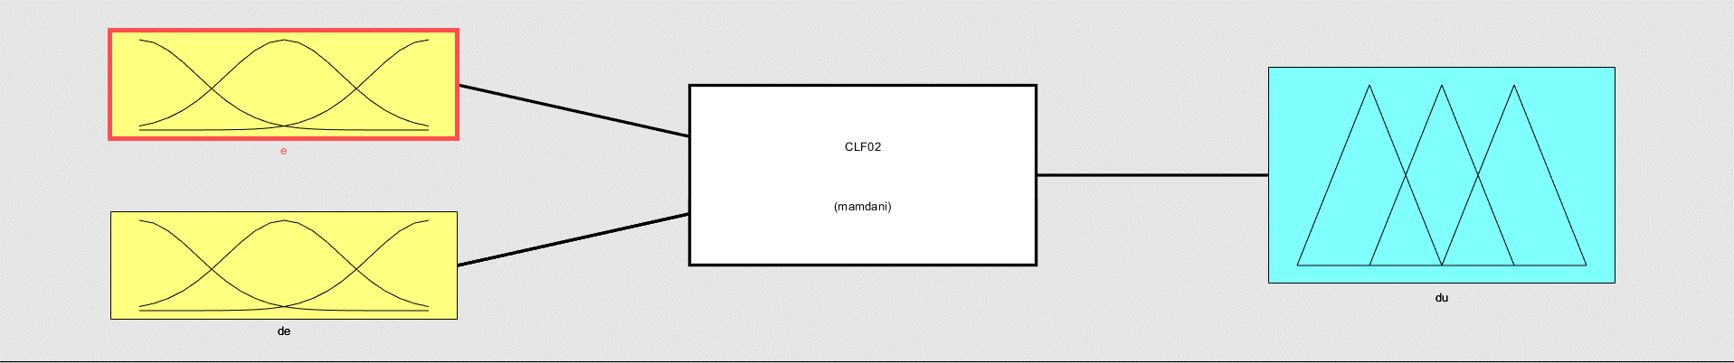
Motor Control with FLC
FLC Model

Slide 16
Motor Control with FLC
Optimization Process of the Fitness function
PSO
GA

Slide 17
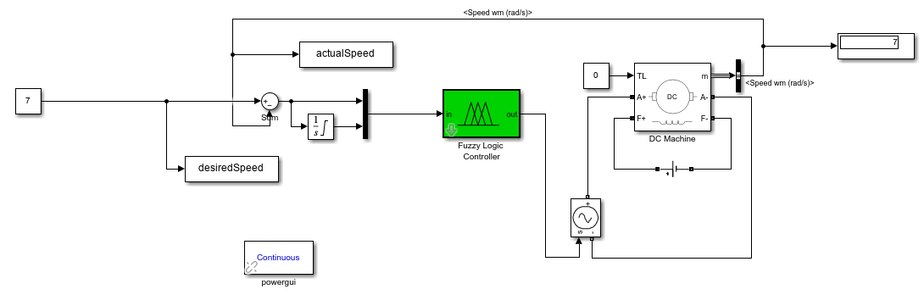
Motor Control with FLC
Optimization Results for GA and PSO

Slide 18
integrating FLC with HOMER software

Slide 19
integrating FLC with HOMER software
My project is divided into three stages
Stage 1: involves the initial design of the FLC and the development of a PSO and GA strategy
Stage 2: is focused on the tuning of the FLC using the PSO and GA algorithm
Stage 3: we integrate this optimized FLC into the HOMER software for practical energy system analysis

Slide 20
integrating FLC with HOMER software
Flow Chart

Slide 21
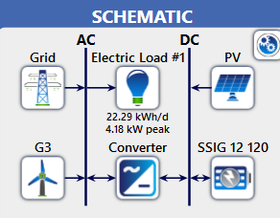
integrating FLC with HOMER software
System Schematic

Slide 22
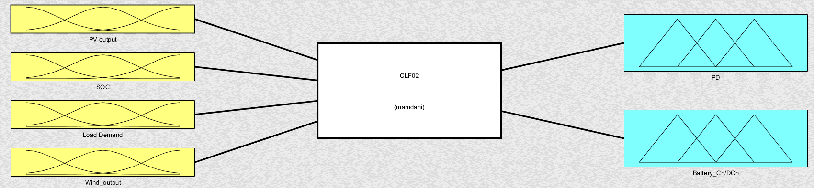
integrating FLC with HOMER software
FLC Model

Slide 23
integrating FLC with HOMER software
Results:

Slide 24
integrating FLC with HOMER software
Results:
Controller | sys cost | Battery cost | PV production KWh/yr | Wind production KWh/yr | Grid purchases KWh/yr | Grid Sales KWh/yr | Load KWh/yr
(CC+LF) | $25341 | $230 | 7,794 | 4,760 | 3,215 | 7,087 | 8,136
FLC_PSO | $25274 | $230 | 6,572 | 4,760 | 4,535 | 3,549 | 8,136
FLC_GA | $38740 | $13,460 | 5,202 | 4,760 | 4,771 | 2,888 | 8,136

Slide 25
integrating FLC with HOMER software
Results:

Slide 26
Thank you

